Slide 1
Welcome to Aix-en-Provence !

Slide 2
General informations
The LOC:
Thierry Appourchaux
Stephane Caminade
Catherine Cougrand
Delphine Prival
Jean-Paul Rozet
WIFI:
Network name: Centre de congrès
Password: gongsoho

Slide 3
Presentations
Two possibilities:
Use your own laptop
Use the conference center computer
In either case
Hand over your file (ppt or pdf) to the LOC
Please come to us at the coffee break taking place before your session for checking it out

Slide 4
Conference Proceedings
Journal of Physics: conference series
All papers shall be refeered
10 pages for Review paper (2 color pages)
10 pages for Prospective papers (1 color page)
6 pages for Oral contributions (color page if wished)
4 pages for Poster (No color page)
Editorial board: part of the SOC + John Leibacher
Author guidelines:
www.iop.org/EJ/journal/~page=extra.3/1742-6596
Deadline is October 1st , 2010 (very strict !)

Slide 5
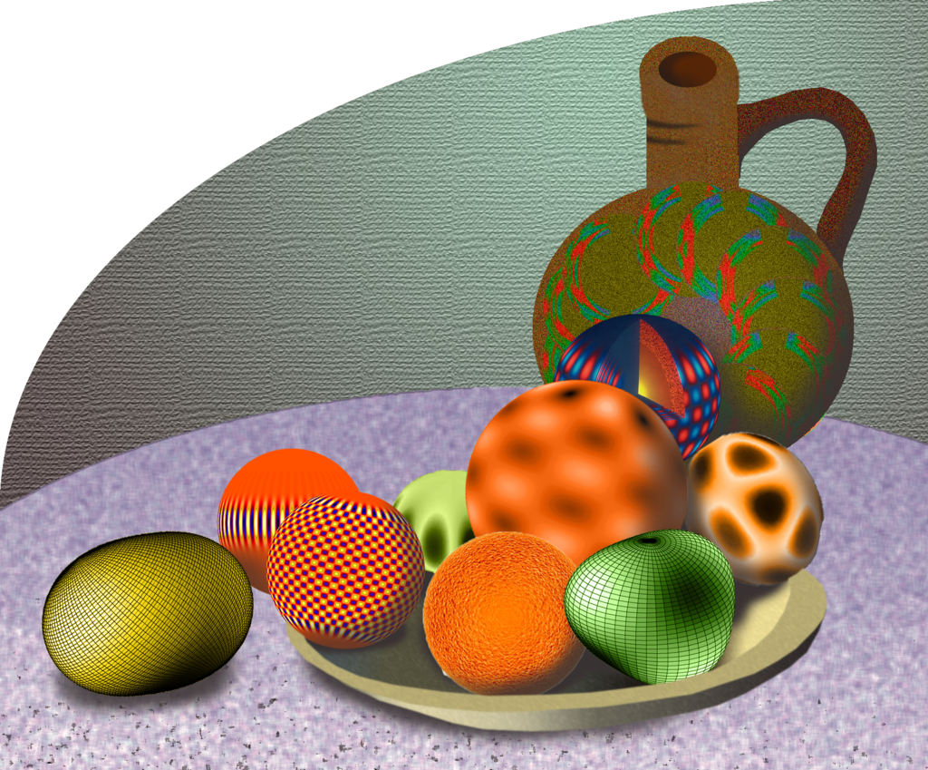
Thanks to Rachel Howe for the conference logo !

Slide 6
Monday June 28, 2010
Guided visit of Aix-en-Provence (1 hour by foot)
Meeting point is Conference center @ 18:15
4 groups, 4 guides, 4 colors:
each of you should have a colored ticket, if not please come to us !
Start of the visit @ 18:30
End of the visit @ 19:30 at Pavillon de Vendôme
Reception at the Pavillon @ 19:30

Slide 7
Excursion to Cassis and its calanques
Meeting point: Conference center
Departure of the buses for Cassis @ 9:30 sharp !
In Cassis transfer to the harbor by small trains of two groups @ 10:30 and @ 10:45
Boat trip @ 11:30 (1 hour)
Lunch at "Le Grand Large" @ 12:45
Return to the buses by small trains of two groups @ 16:30 and @ 16:45

Slide 8
Thursday July 1st, 2010
Conference dinner at Le Chateau de la Pioline
Meeting point is conference center @ 19:00
Return at 23:00 with 3 buses:
Bus 1: Mozart / Atrium
Bus 2: Globe / Artea / De France / Augustins
Bus 3: Jas de Bouffan / Rotonde
If your hotel is not listed above, please let us know!

